Slide 1
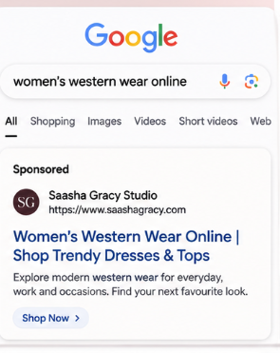
Paid Advertising Blueprint
Sanjana Sharon S
TASK 2

Slide 2
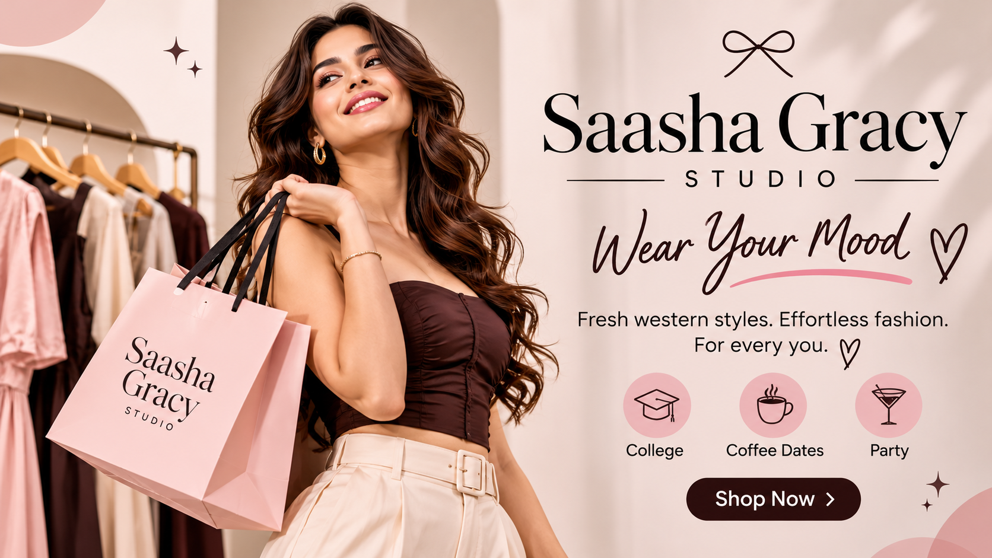
PAID AVERTISING BLUEPRINT
Campaign objective: generate qualified traffic, product discovery and first purchases.
Channels: Meta Ads + Google Ads
Core audience: women 18–34 in India, with launch focus on metro and Tier-1 cities.
Positioning: modern, accessible western wear for confident everyday and occasion styling.

Slide 3
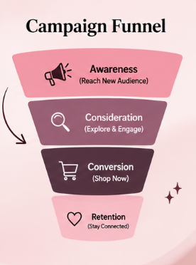
CAMPAIGN FUNNEL
TOFU — Reels/video + broad interest audiences: introduce brand, style and hero products.
MOFU — Carousel/collection ads + site visitors/video viewers: show product range, social proof and styling ideas.
BOFU — Dynamic/product ads + high-intent Google Search: capture shoppers close to purchase.
Retention — customer list, repeat-purchase creatives and new-drop announcements.

Slide 4
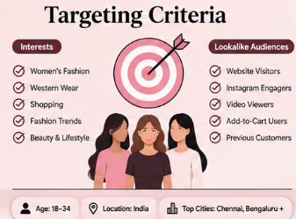
Target Audience
Primary: women 18–34; students, early-career professionals and fashion-conscious shoppers.
Geography: India; prioritize Chennai, Bengaluru, Hyderabad, Mumbai, Delhi NCR, Pune and other high-intent urban markets.
Interests: women's fashion, dresses, online shopping, street style, fashion influencers, beauty/lifestyle, accessories.
Lookalikes: website visitors, Instagram engagers, add-to-cart users and purchasers once enough first-party data is available.
Creative segments: college/casual, workwear, date-night and party styling.

Slide 5
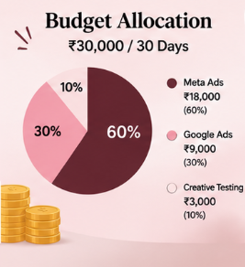
Budget Allocation — Starter Test
Meta Ads — ₹18,000 (60%): discovery, Reels, carousel and retargeting.
Google Ads — ₹9,000 (30%): high-intent Search + brand/non-brand keyword tests.
Creative testing reserve — ₹3,000 (10%): refresh weak creatives and test new hooks.
Pacing: start at ~₹1,000/day; review after 7 days and shift spend toward lower CPA / higher ROAS ad sets.
Budget is a sample internship exercise, not a forecast of guaranteed results.

Slide 6
Meta Ad Copy Variations
Option A — “Your everyday look, upgraded.” | Discover easy western styles made for repeat wear. Shop the latest edit.
Option B — “One dress. So many plans.” | From college days to coffee dates, find styles that move with you. Shop now.
Option C — “Wear your mood.” | Fresh western silhouettes, easy styling and statement-ready looks. Explore Saasha Gracy Studio.
CTA tests: Shop Now | Explore Collection | Discover Your Style

Slide 7
Google Search Ad Blueprint
Headline 1: Women’s Western Wear Online
Headline 2: Shop Trendy Dresses & Tops
Headline 3: Discover Saasha Gracy Studio
Description: Explore modern western wear for everyday, work and occasions. Find your next favourite look.
Keyword groups: western wear for women | western dresses online | women’s tops online | co-ord sets for women | party wear western dresses.
Landing pages: category-specific, mobile-first and aligned exactly to the searched keyword.

Slide 8
Creative Mockup 01 — Reel Ad
FRAME 1: Close-up product detail + text: “NEW DROP”
FRAME 2: Full outfit transition + text: “Made for your plans.”
FRAME 3: 3 quick looks + text: “College • Coffee • Party”
FRAME 4: Logo + product page + CTA: “SHOP THE EDIT”
Format: 9:16, 10–15 seconds, captions on-screen, strong first 2-second hook.

Slide 9
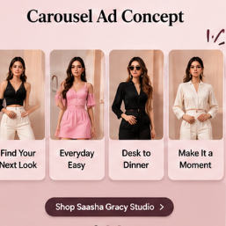
Creative Mockup 02 — Carousel
Card 1: “Find your next look.” — hero outfit
Card 2: “Everyday easy.” — casual look
Card 3: “Desk to dinner.” — work/occasion look
Card 4: “Make it a moment.” — party/date look
Card 5: “Shop Saasha Gracy Studio” — CTA + website

Slide 10
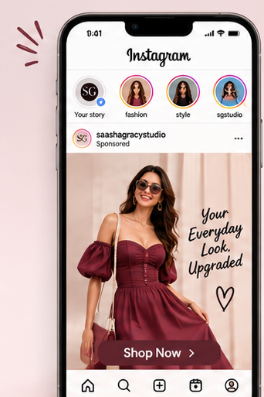
Measurement Dashboard
Awareness: reach, video views, 3-second/ThruPlay rate, CPM.
Traffic: CTR, CPC, landing-page views, engaged sessions.
Commerce: add-to-cart rate, checkout rate, conversion rate, CPA, ROAS.
Creative: hook rate, thumb-stop rate, saves/shares, frequency.
Optimization rule: pause consistently weak ads, refresh creative, and reallocate budget toward stronger audience + creative combinations.

Slide 11
30-Day Test Roadmap
Days 1–7: test 3 hooks × 2 formats × 2 audience groups.
Days 8–14: keep top performers; test landing-page/product-category variations.
Days 15–21: launch retargeting for visitors and engagers; introduce social proof.
Days 22–30: scale winners gradually; refresh fatigued creatives; summarize learnings and next-month budget.
Success = a repeatable combination of audience + creative + landing page, not only one good day of results.

Slide 12
Research Note & Assumptions
Competitor benchmark: FabAlley, a women's fashion brand positioned around contemporary styles at accessible prices. Its official site describes its focus on empowering women through fashion and offers western/party-wear categories.
FabAlley source: official brand/about and category pages; accessed Nov 2026.
Audience, budget, keyword and KPI figures in this deck are internship-planning assumptions and should be validated against actual account data before launch.
Prepared for academic/internship submission — not an official advertising plan for FabAlley.

